Slide 1
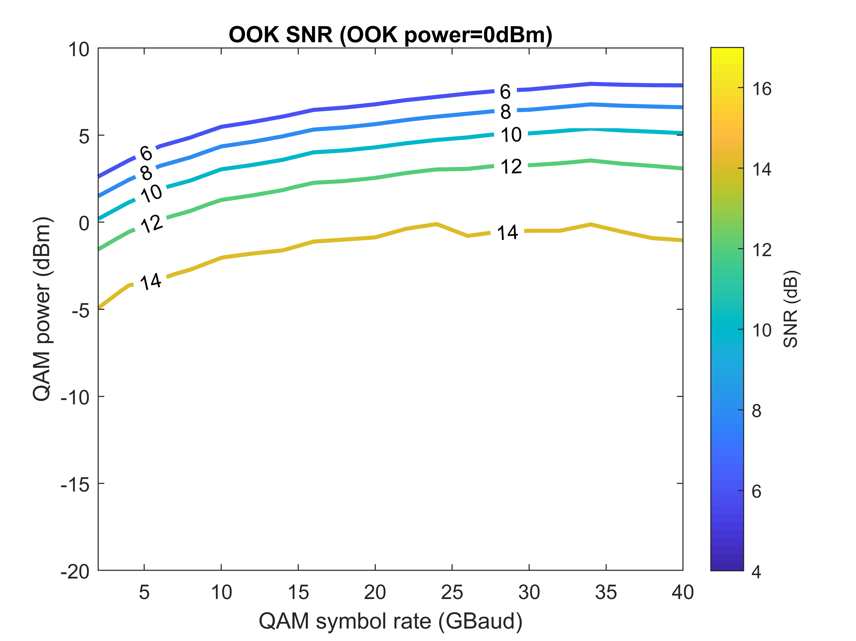
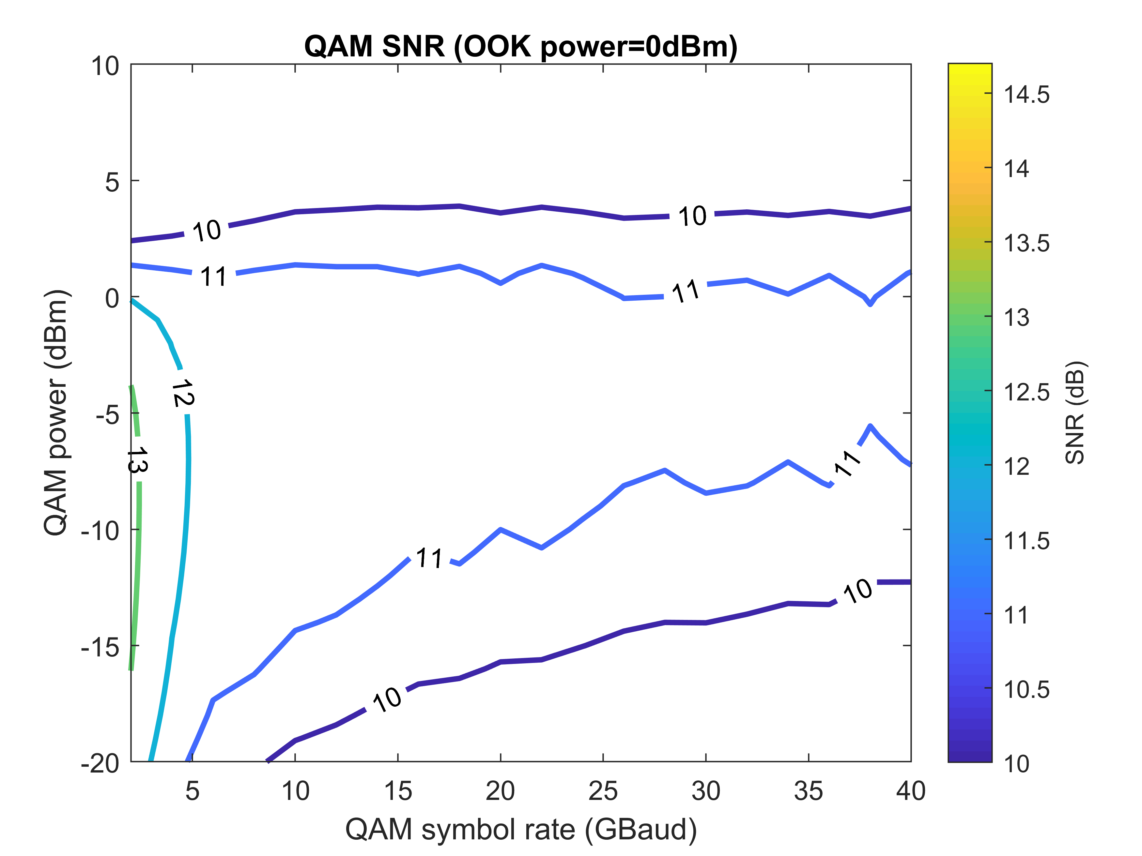
Interleaving OOK and 16QAM – Single Pol.
3OOKs: OOK+QAM+OOK+QAM+OOK, 50 GHz channel spacing

Slide 2
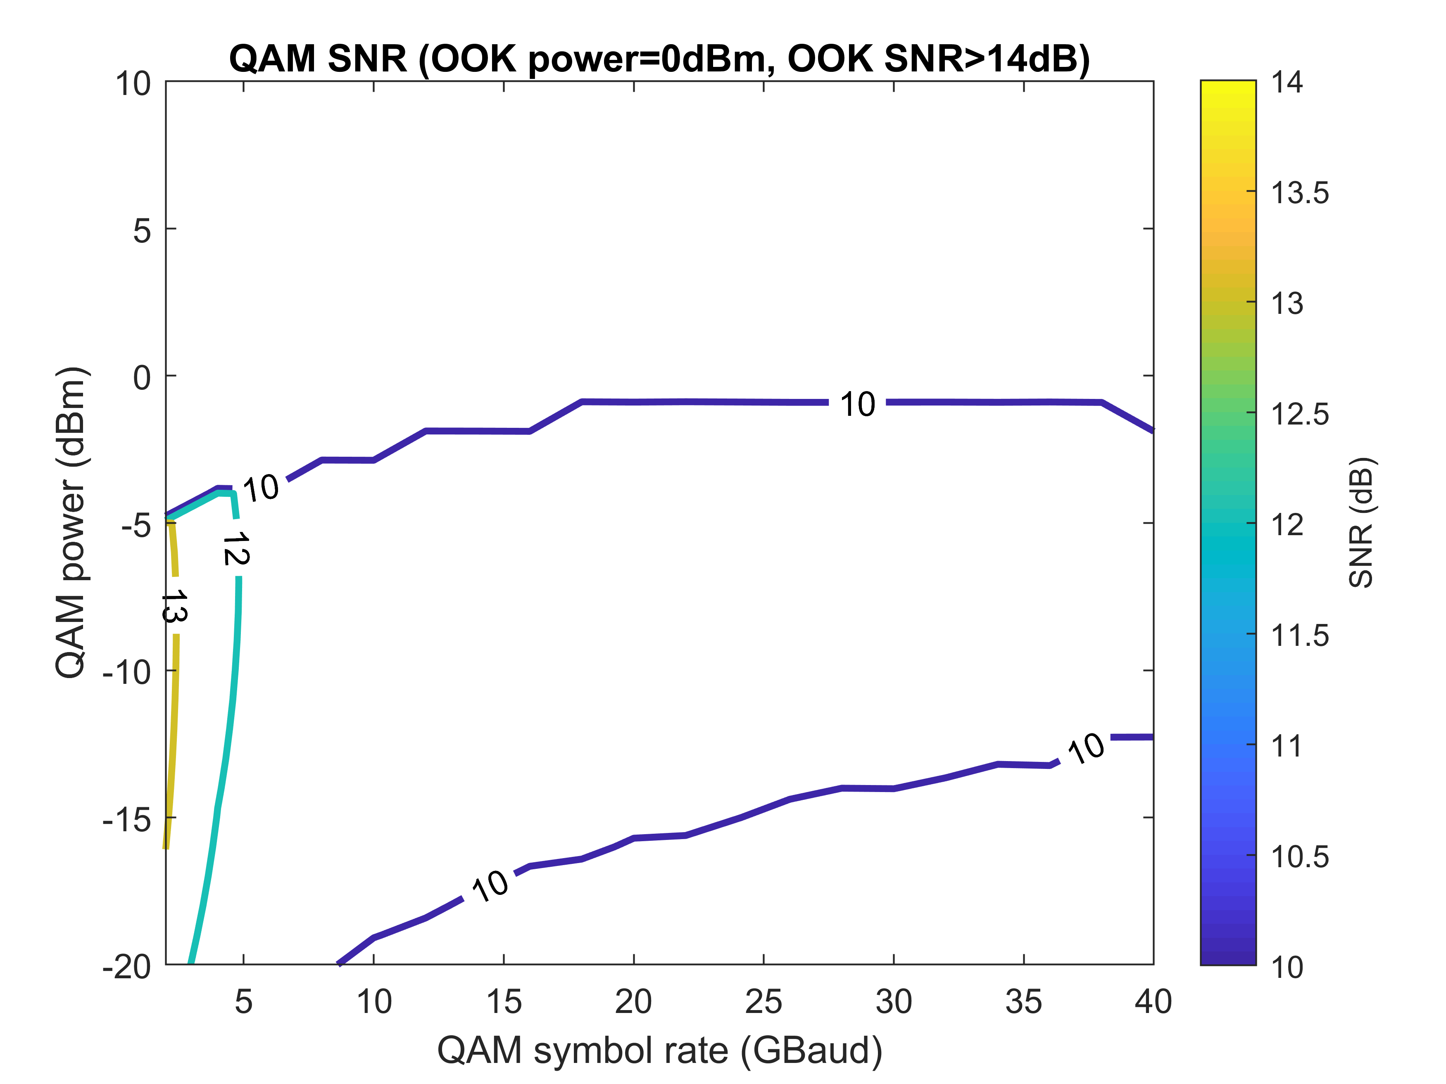
Interleaving OOK and 16QAM – Single Pol.
3OOKs: OOK+QAM+OOK+QAM+OOK, 50 GHz channel spacing

Slide 3
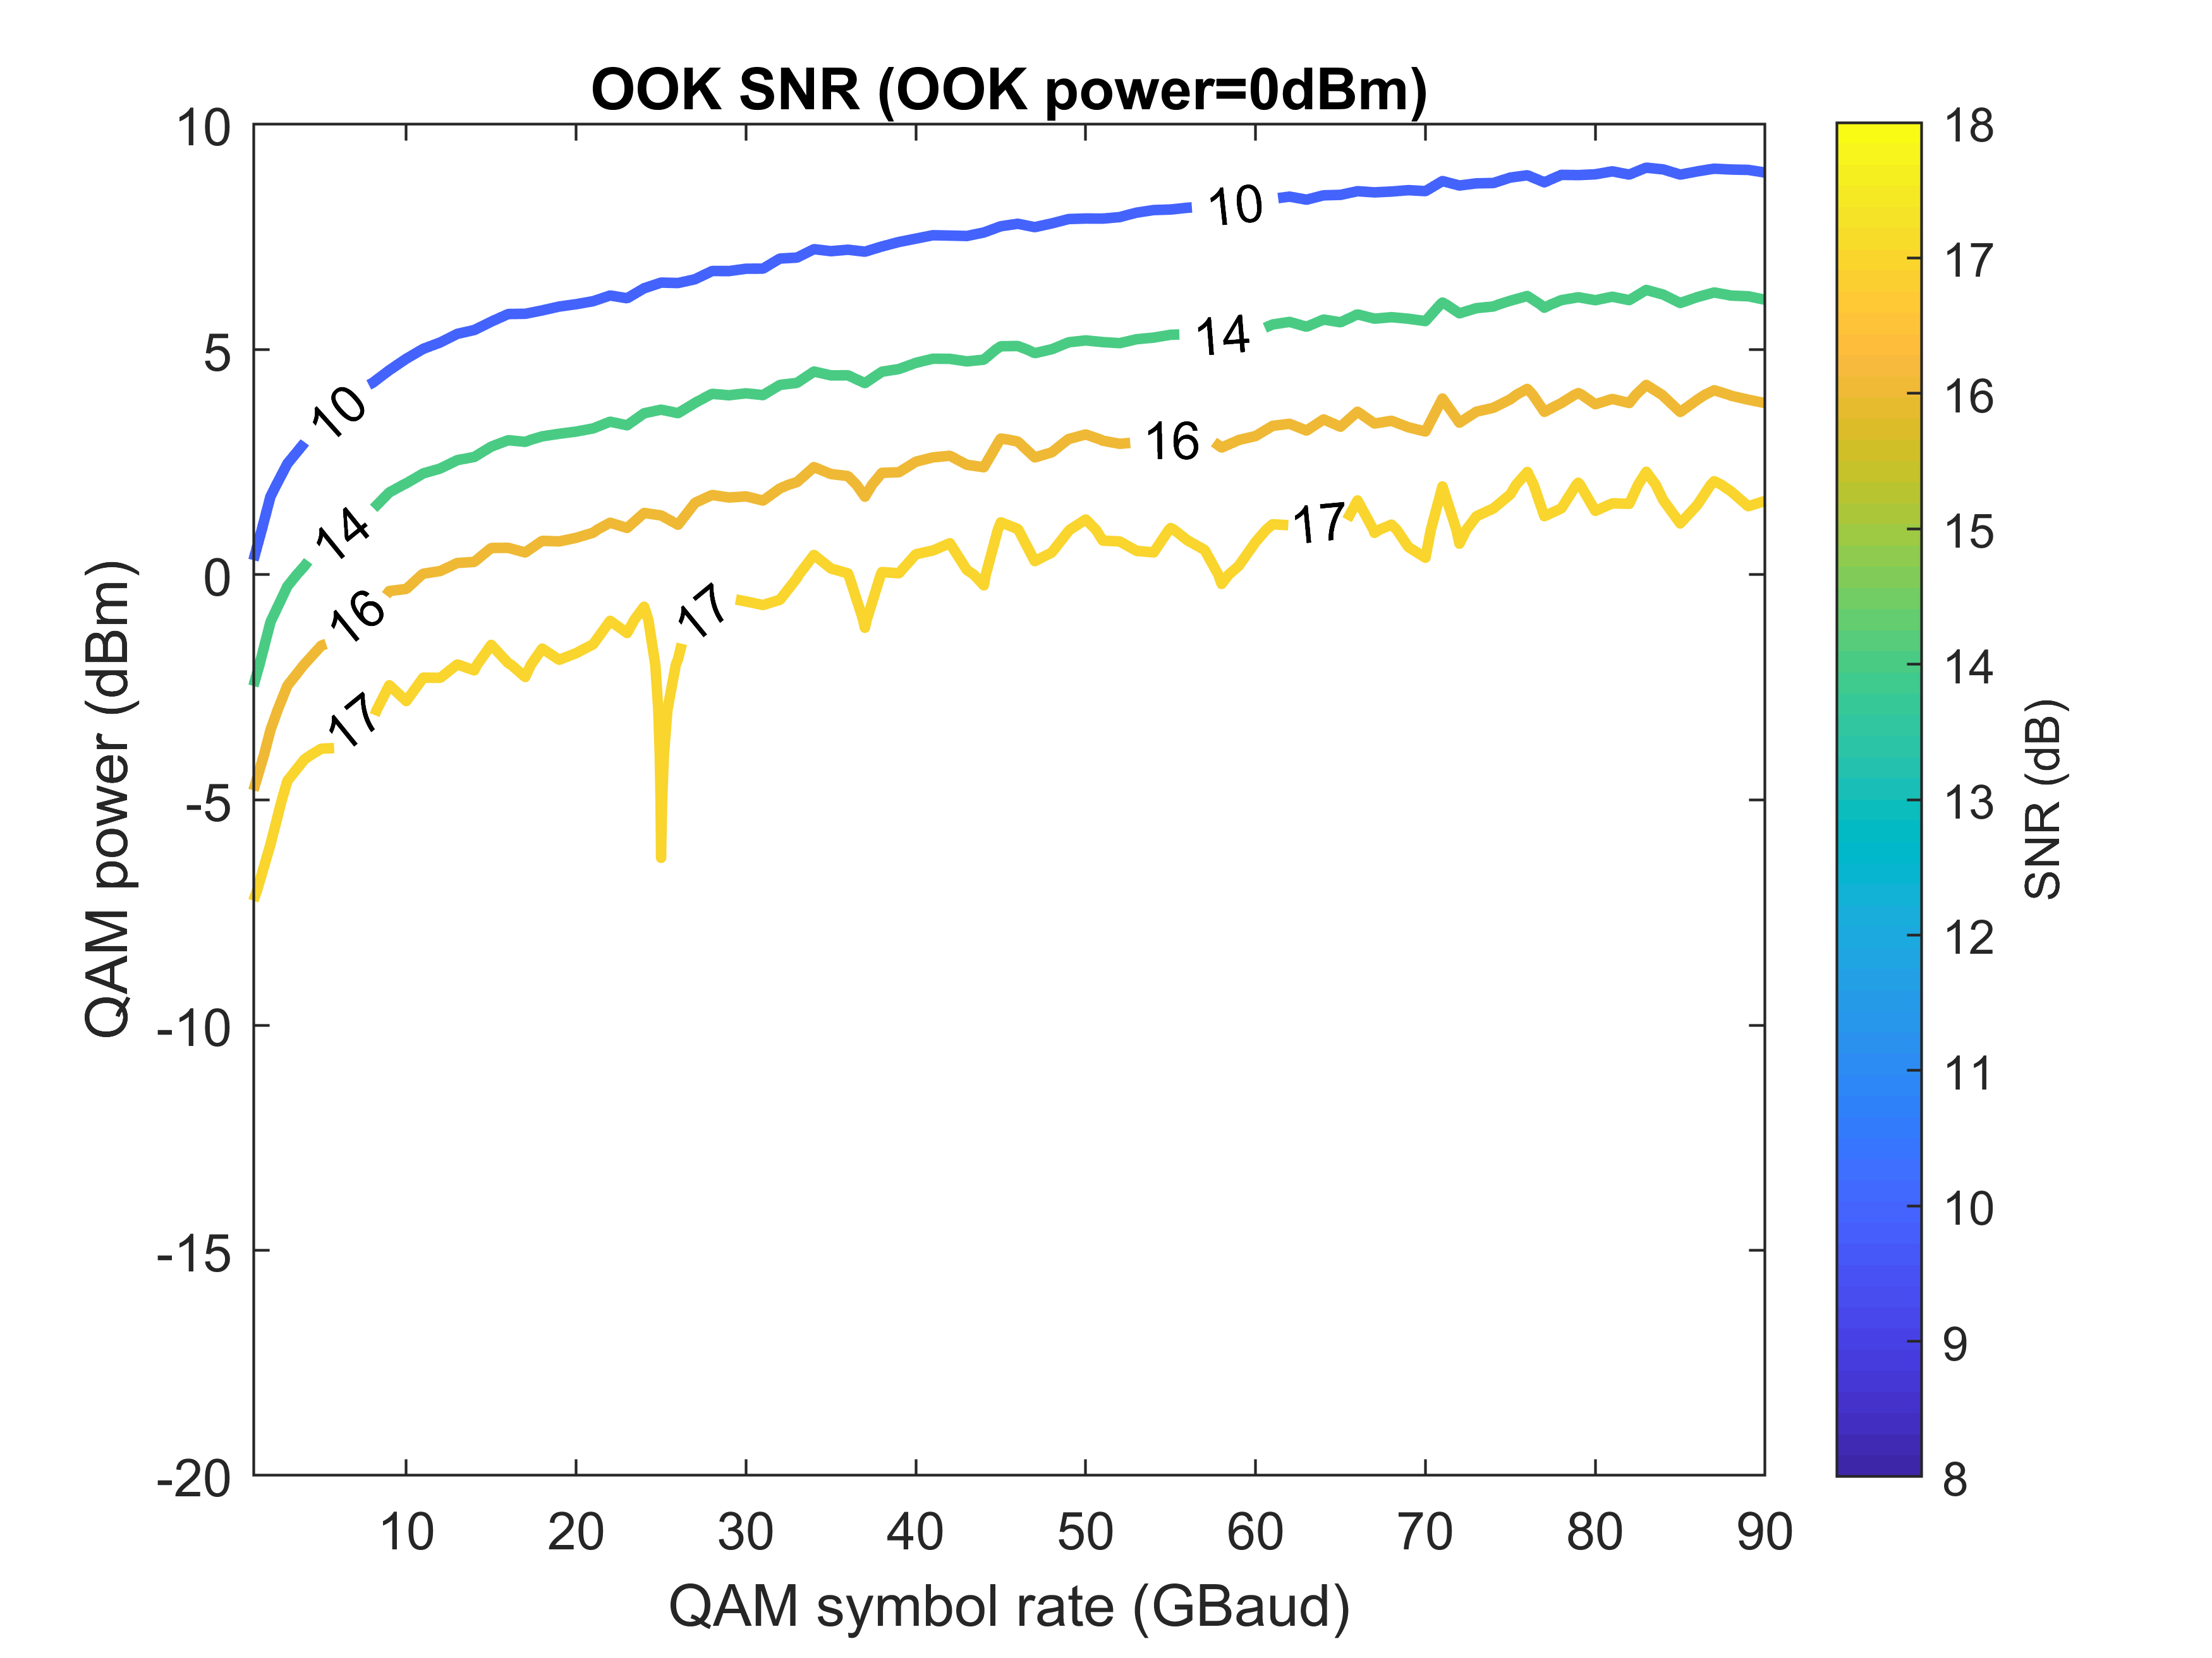
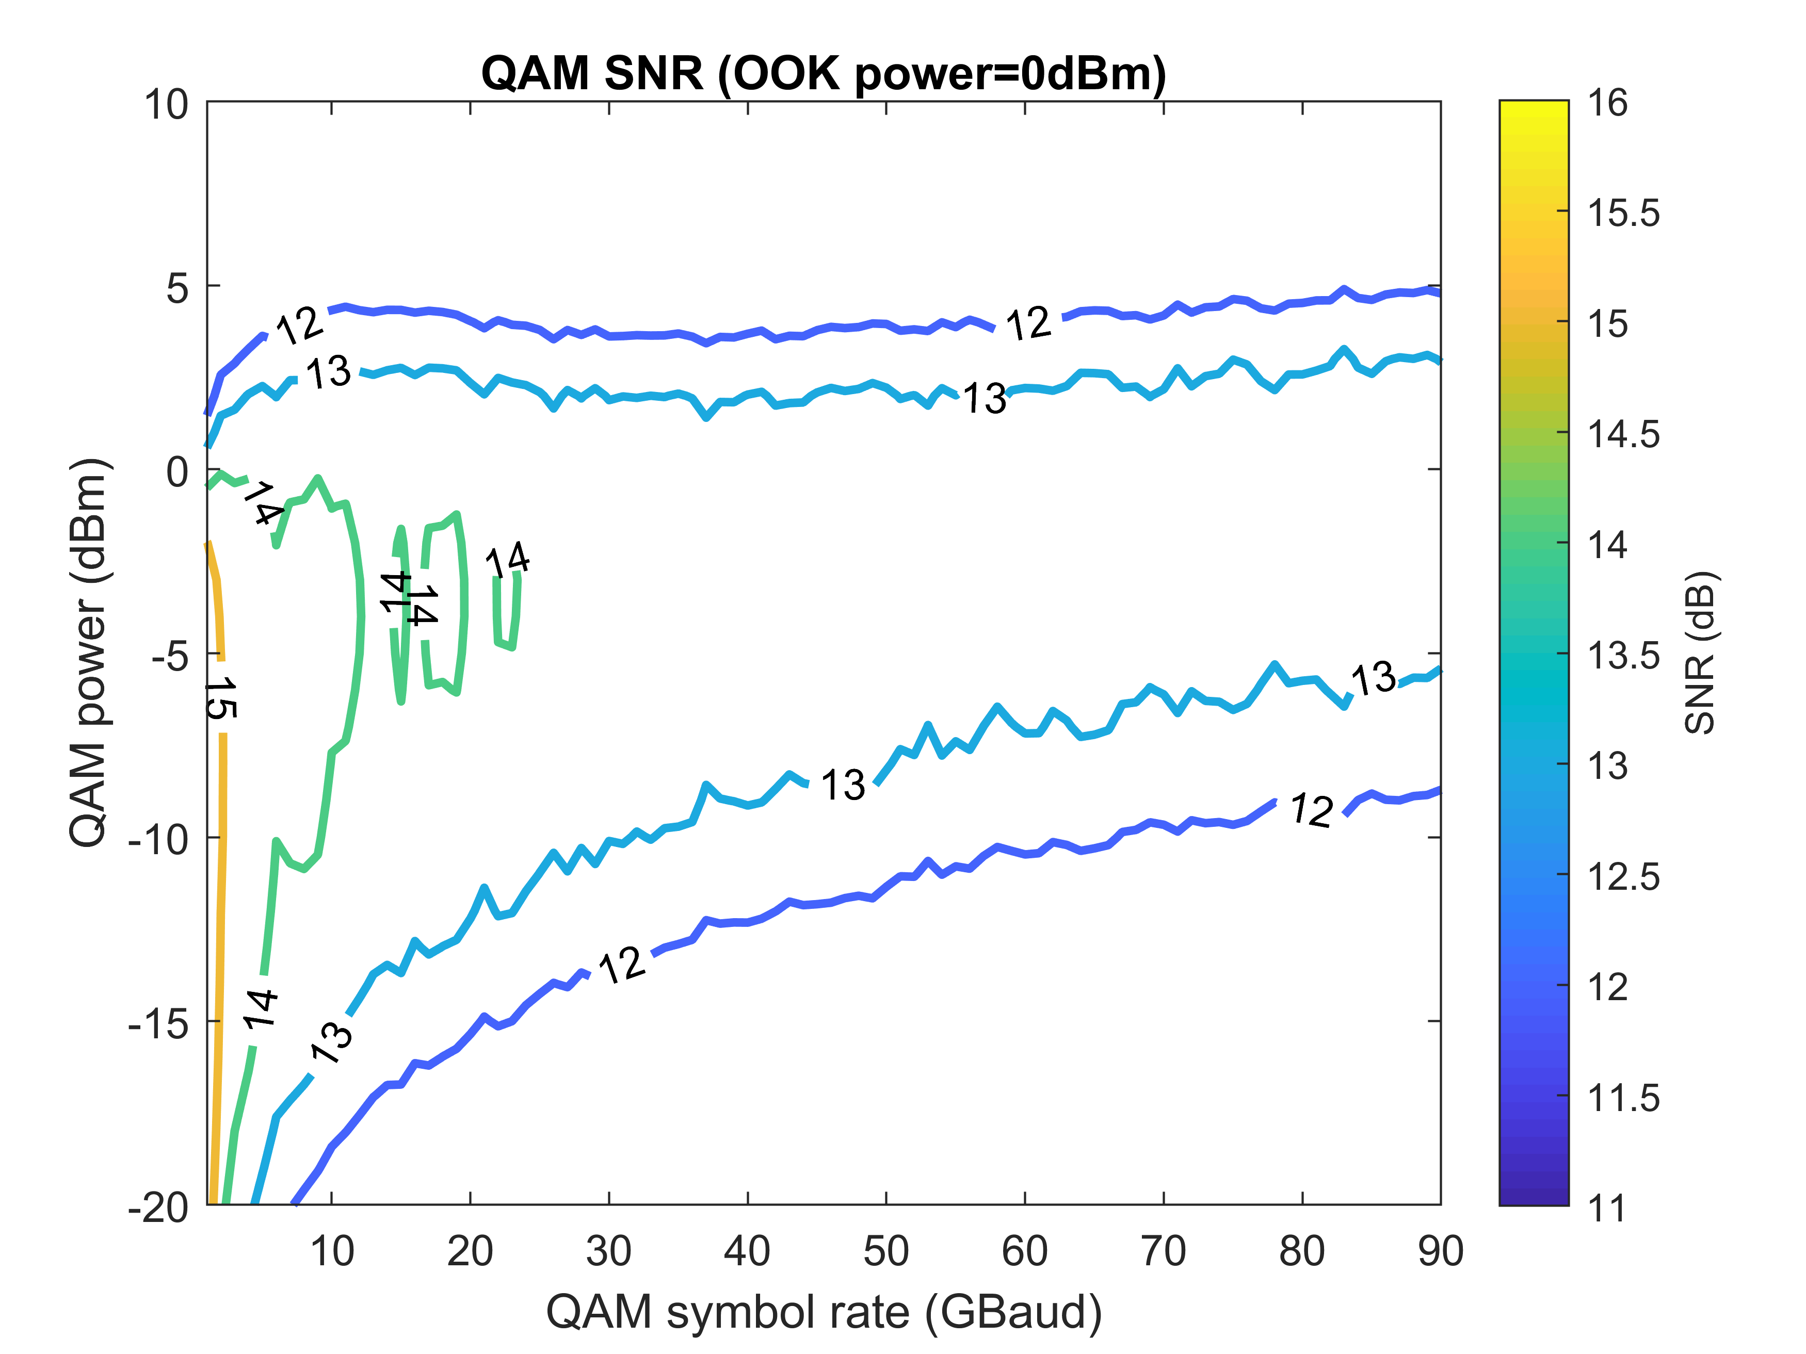
Interleaving OOK and 16QAM – Single Pol.
3OOKs: OOK+QAM+OOK+QAM+OOK, 100 GHz channel spacing

Slide 4
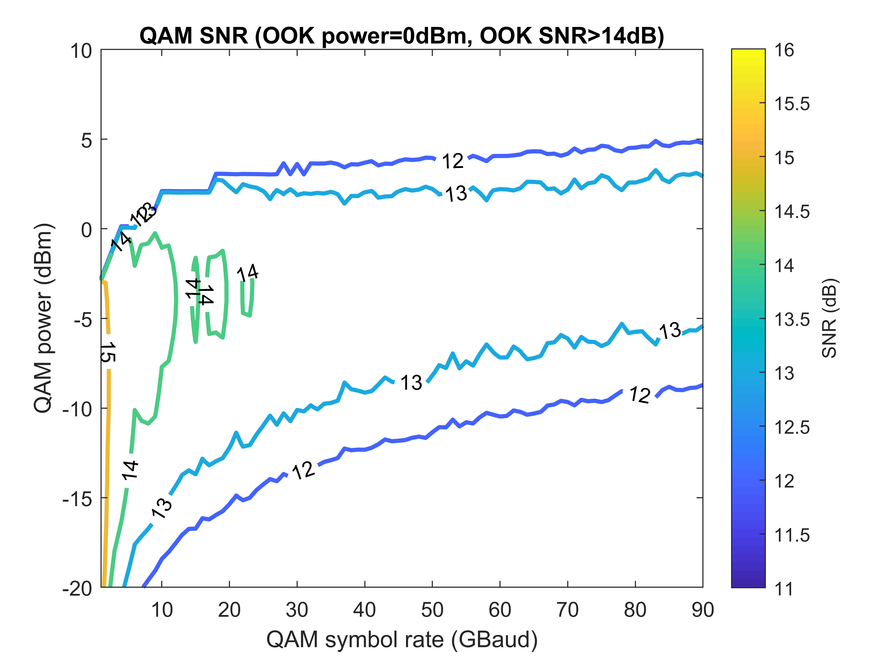
Interleaving OOK and 16QAM – Single Pol.
3OOKs: OOK+QAM+OOK+QAM+OOK, 100 GHz channel spacing

Slide 5
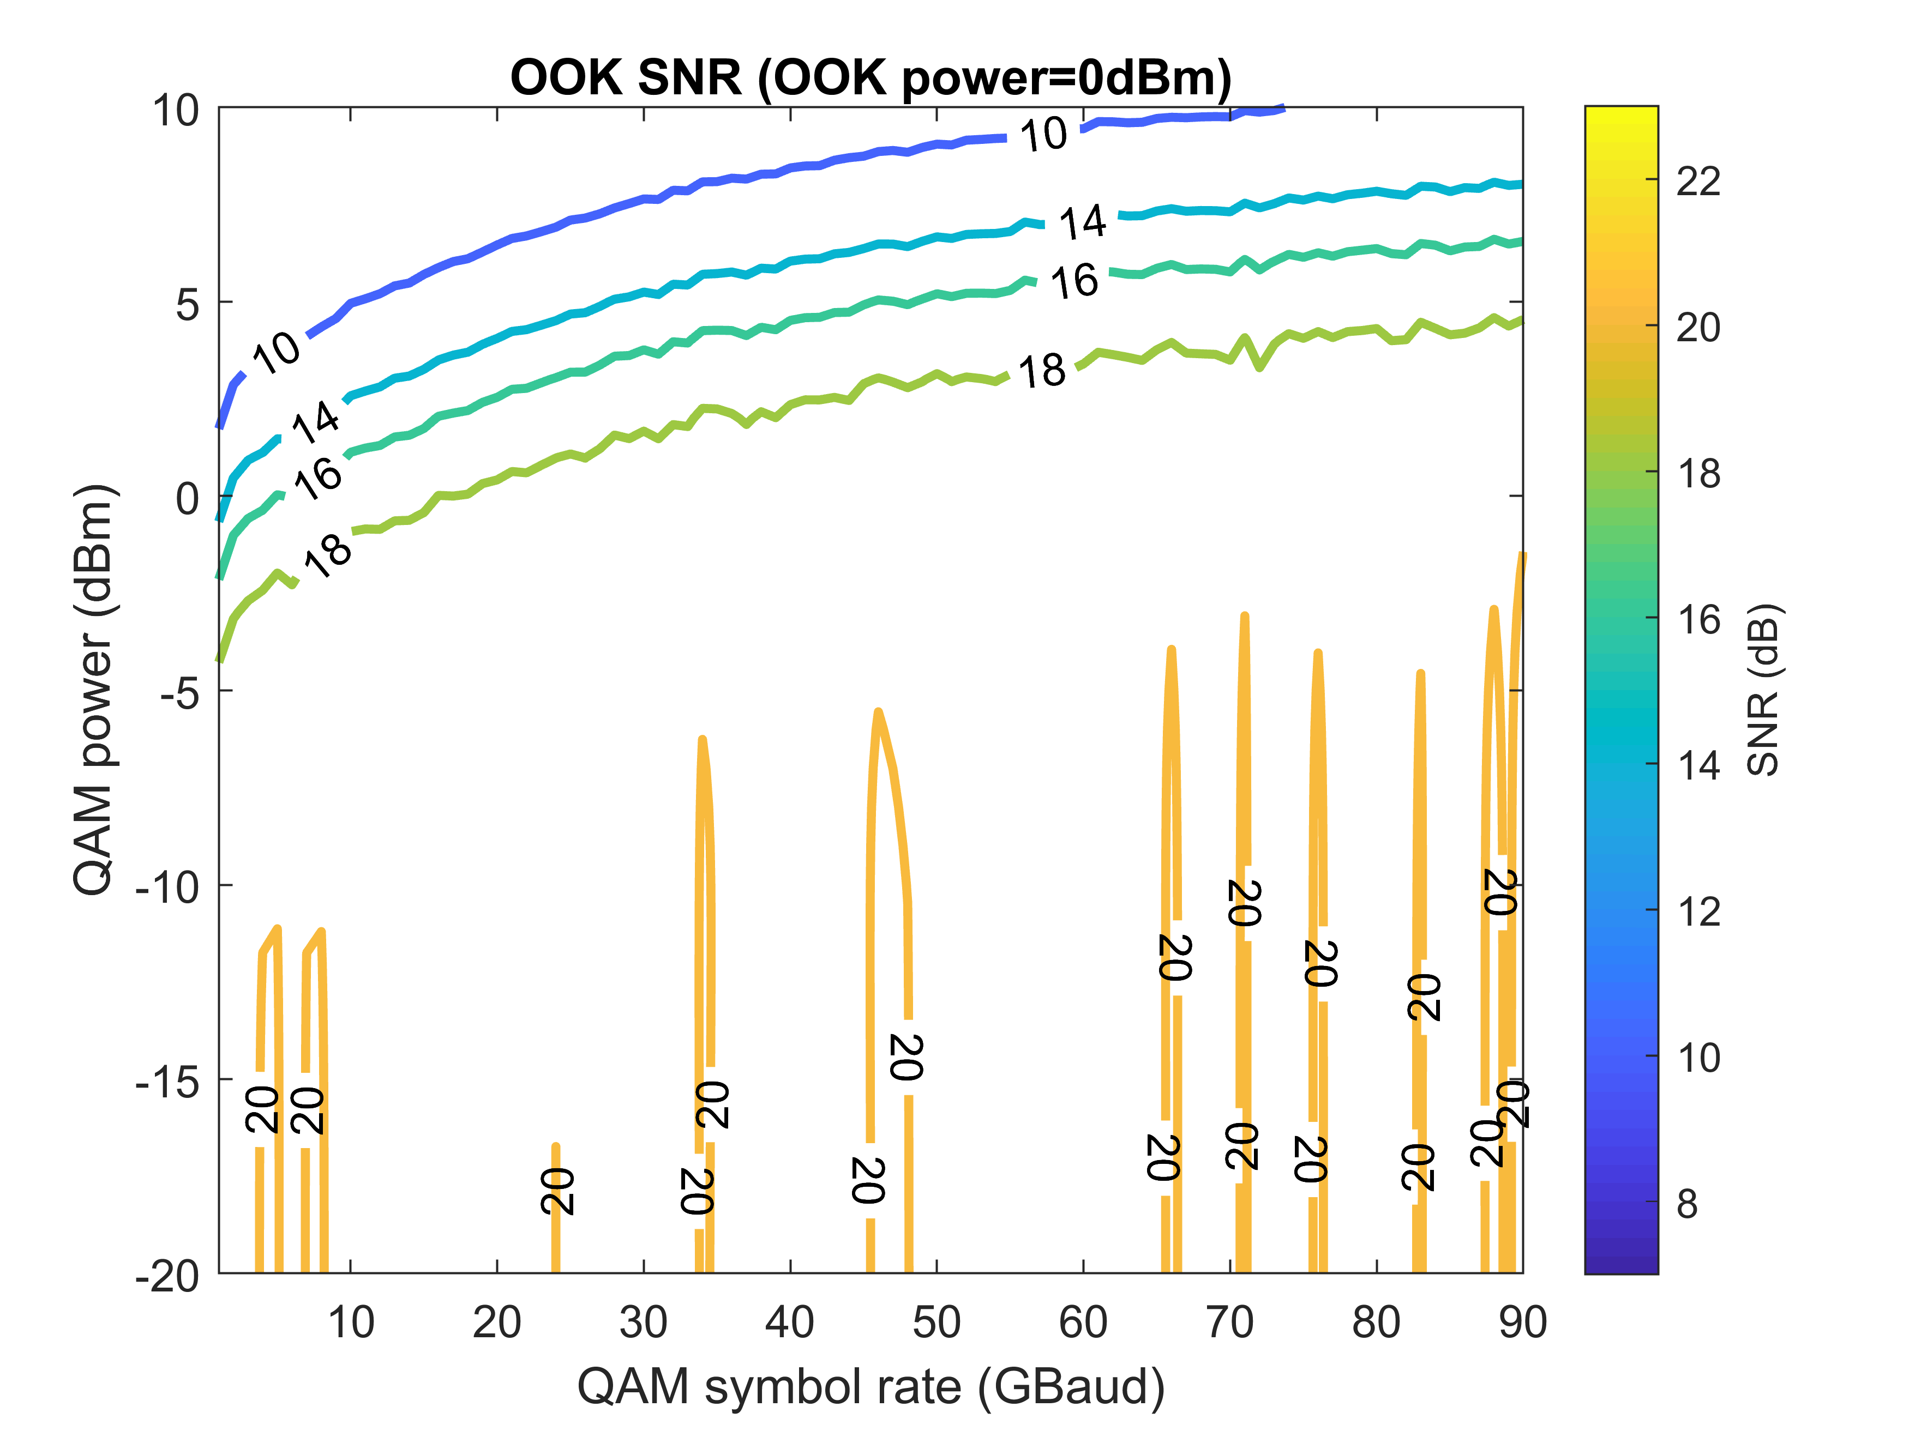
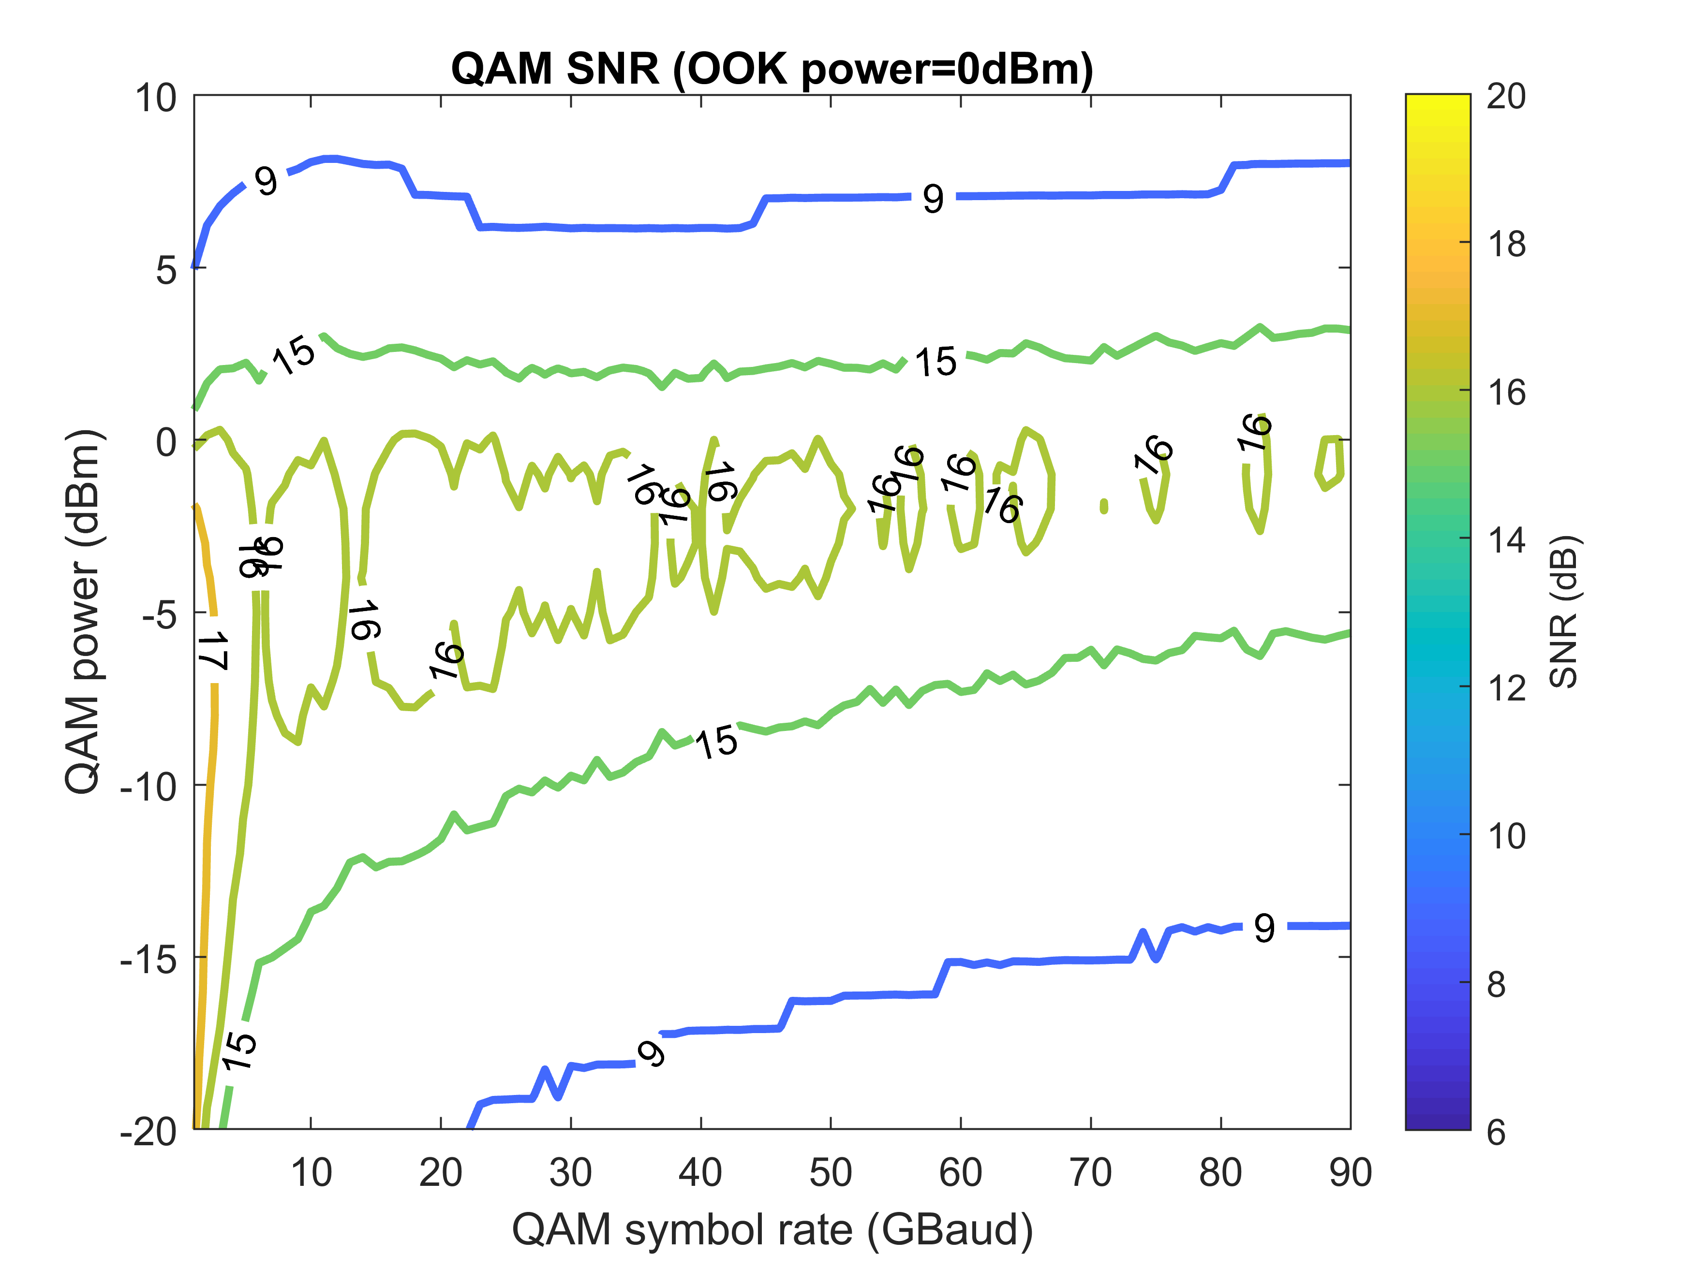
Interleaving OOK and 16QAM – Single Pol.
3OOKs: OOK+QAM+OOK+QAM+OOK, 200 GHz channel spacing

Slide 6
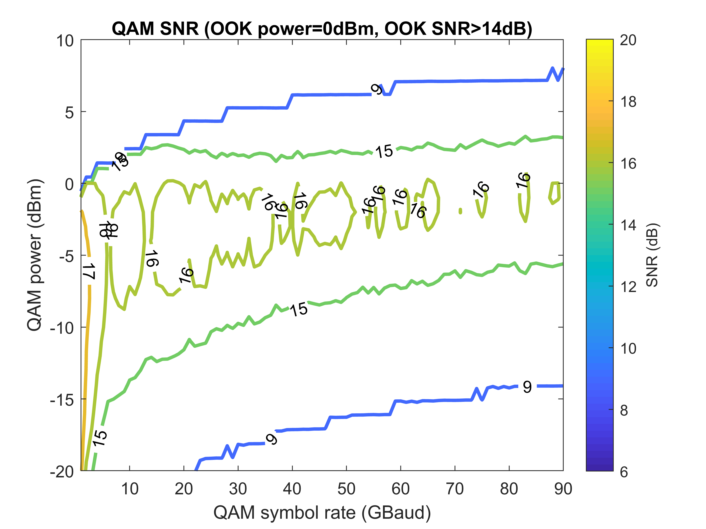
Interleaving OOK and 16QAM – Single Pol.
3OOKs: OOK+QAM+OOK+QAM+OOK, 200 GHz channel spacing

Slide 7
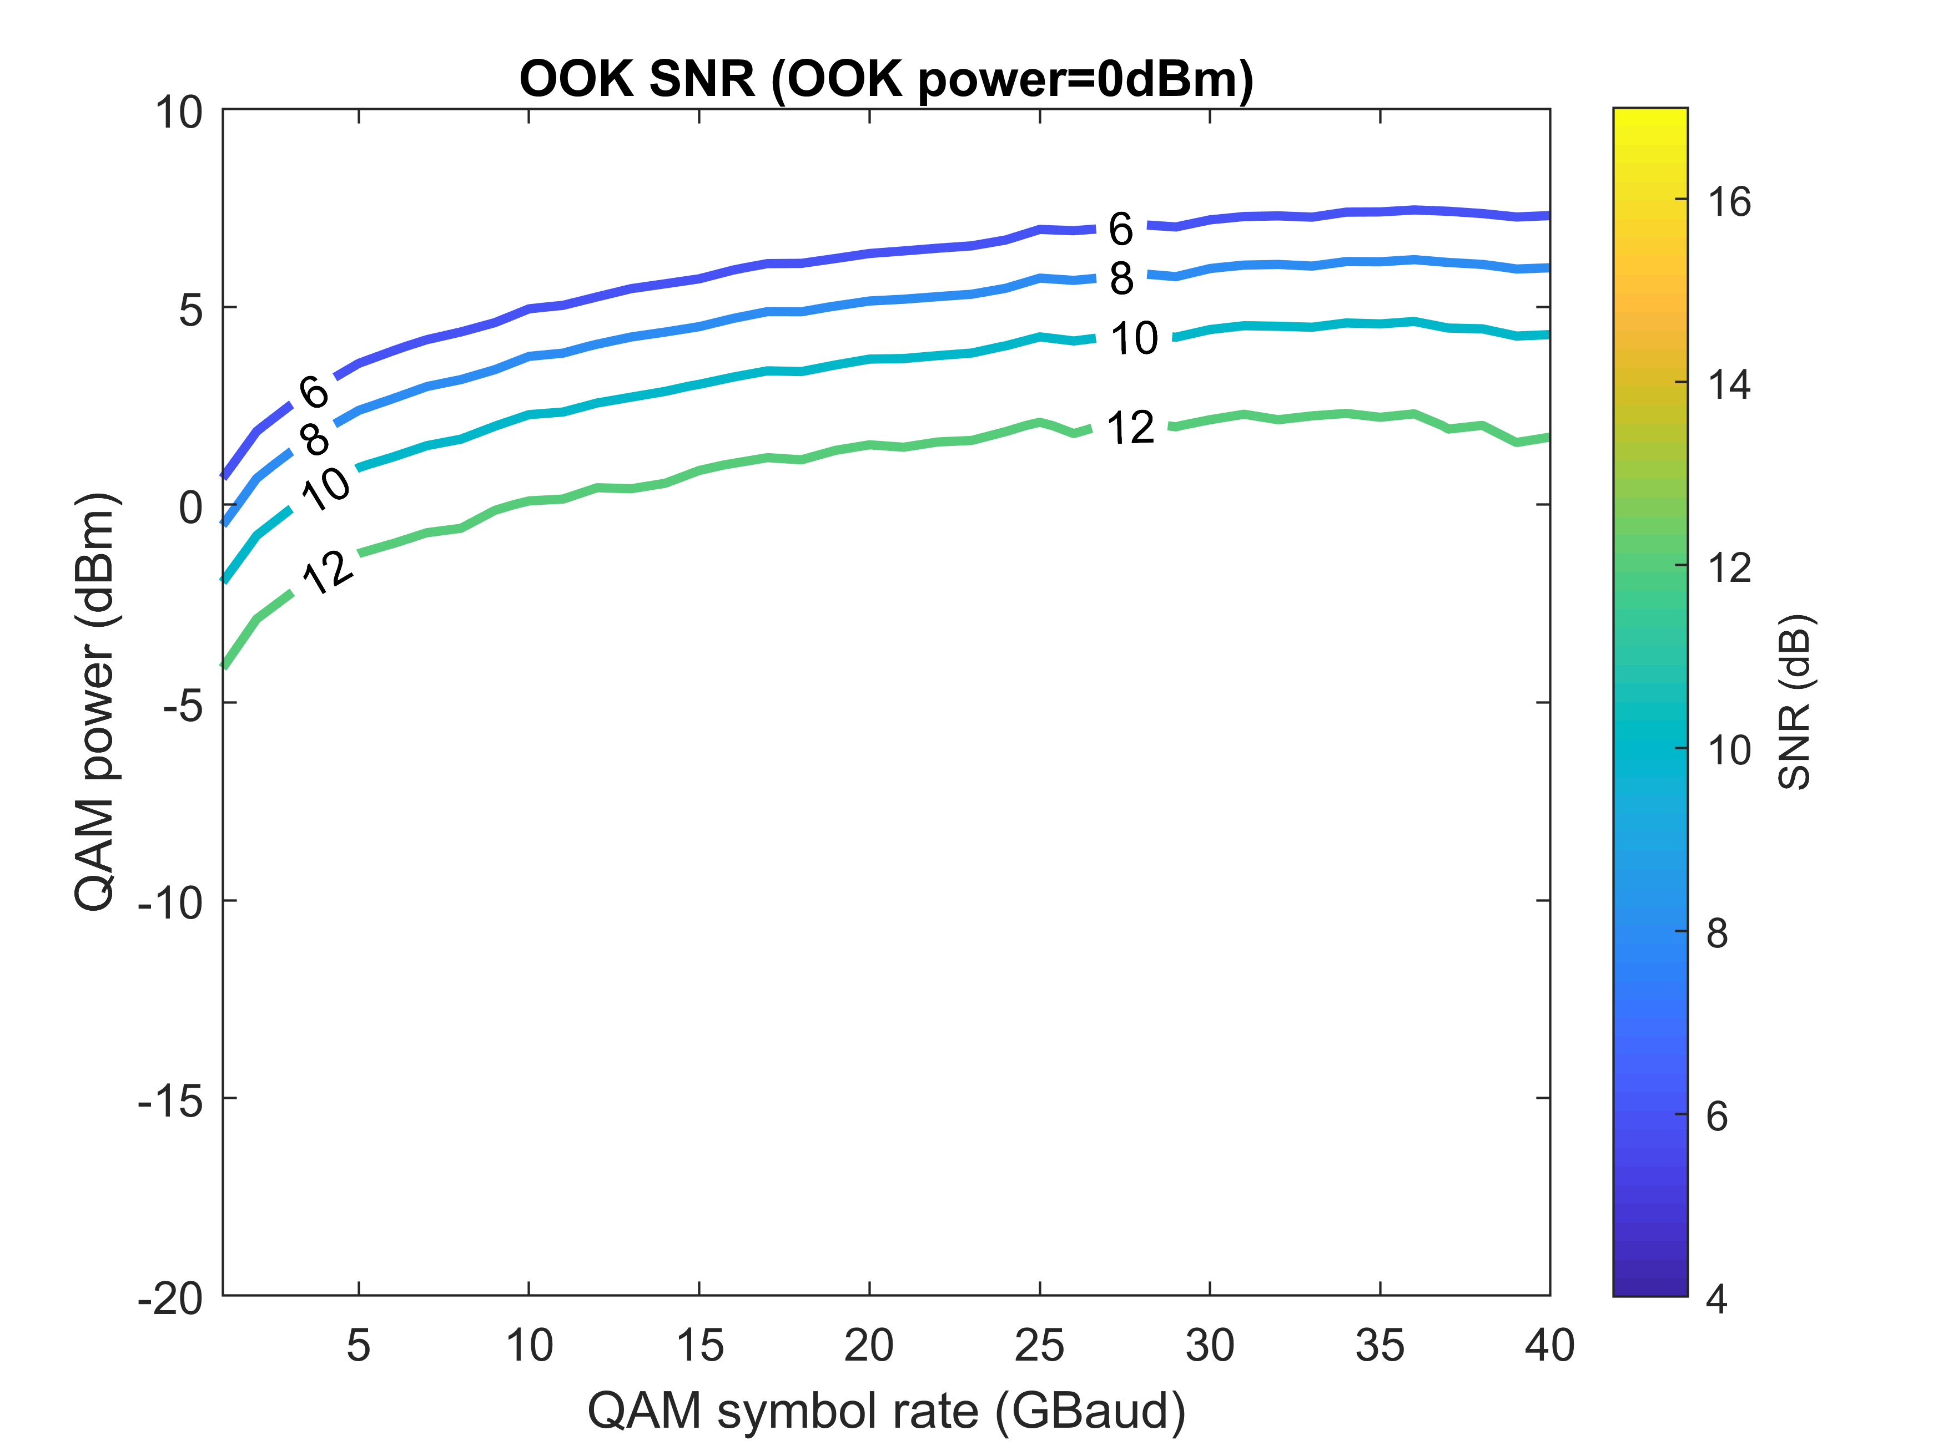
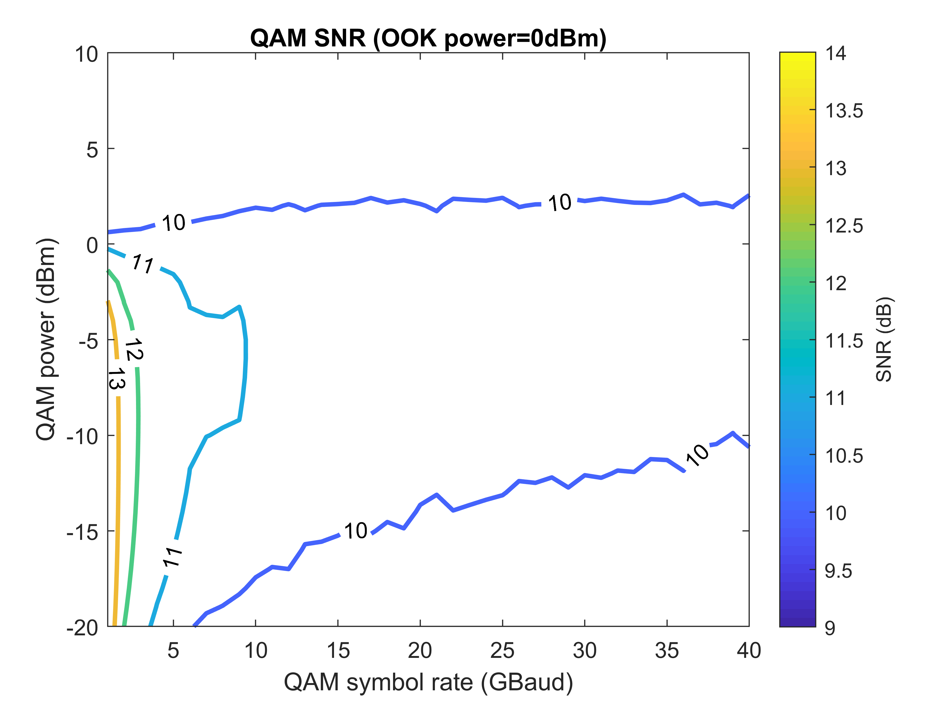
Interleaving OOK and 16QAM – Single Pol.
4OOKs: 50 GHz channel spacing

Slide 8
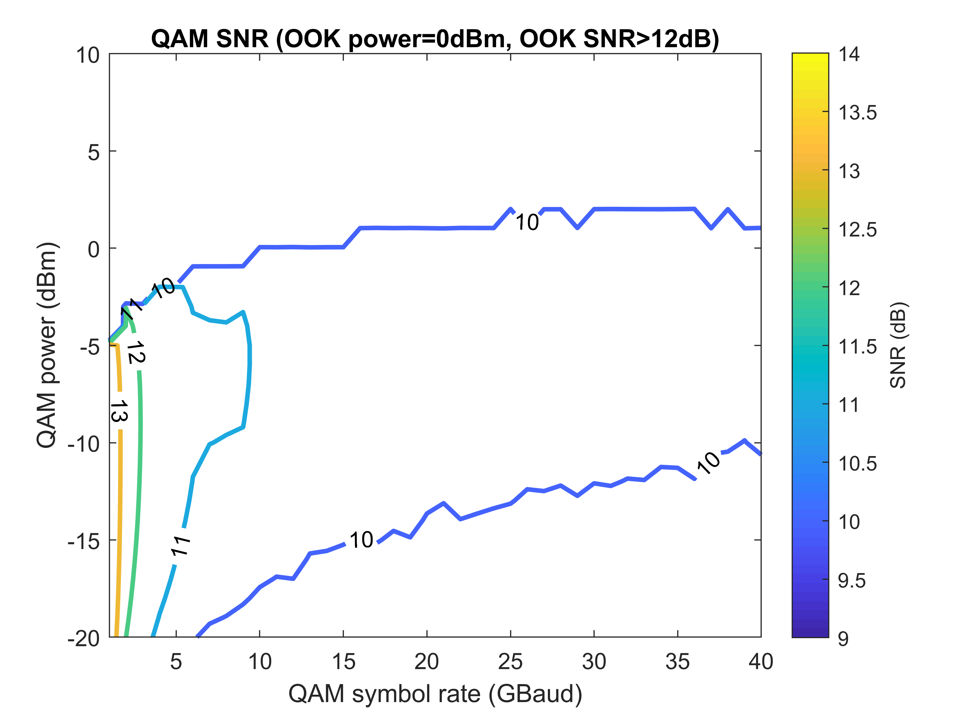
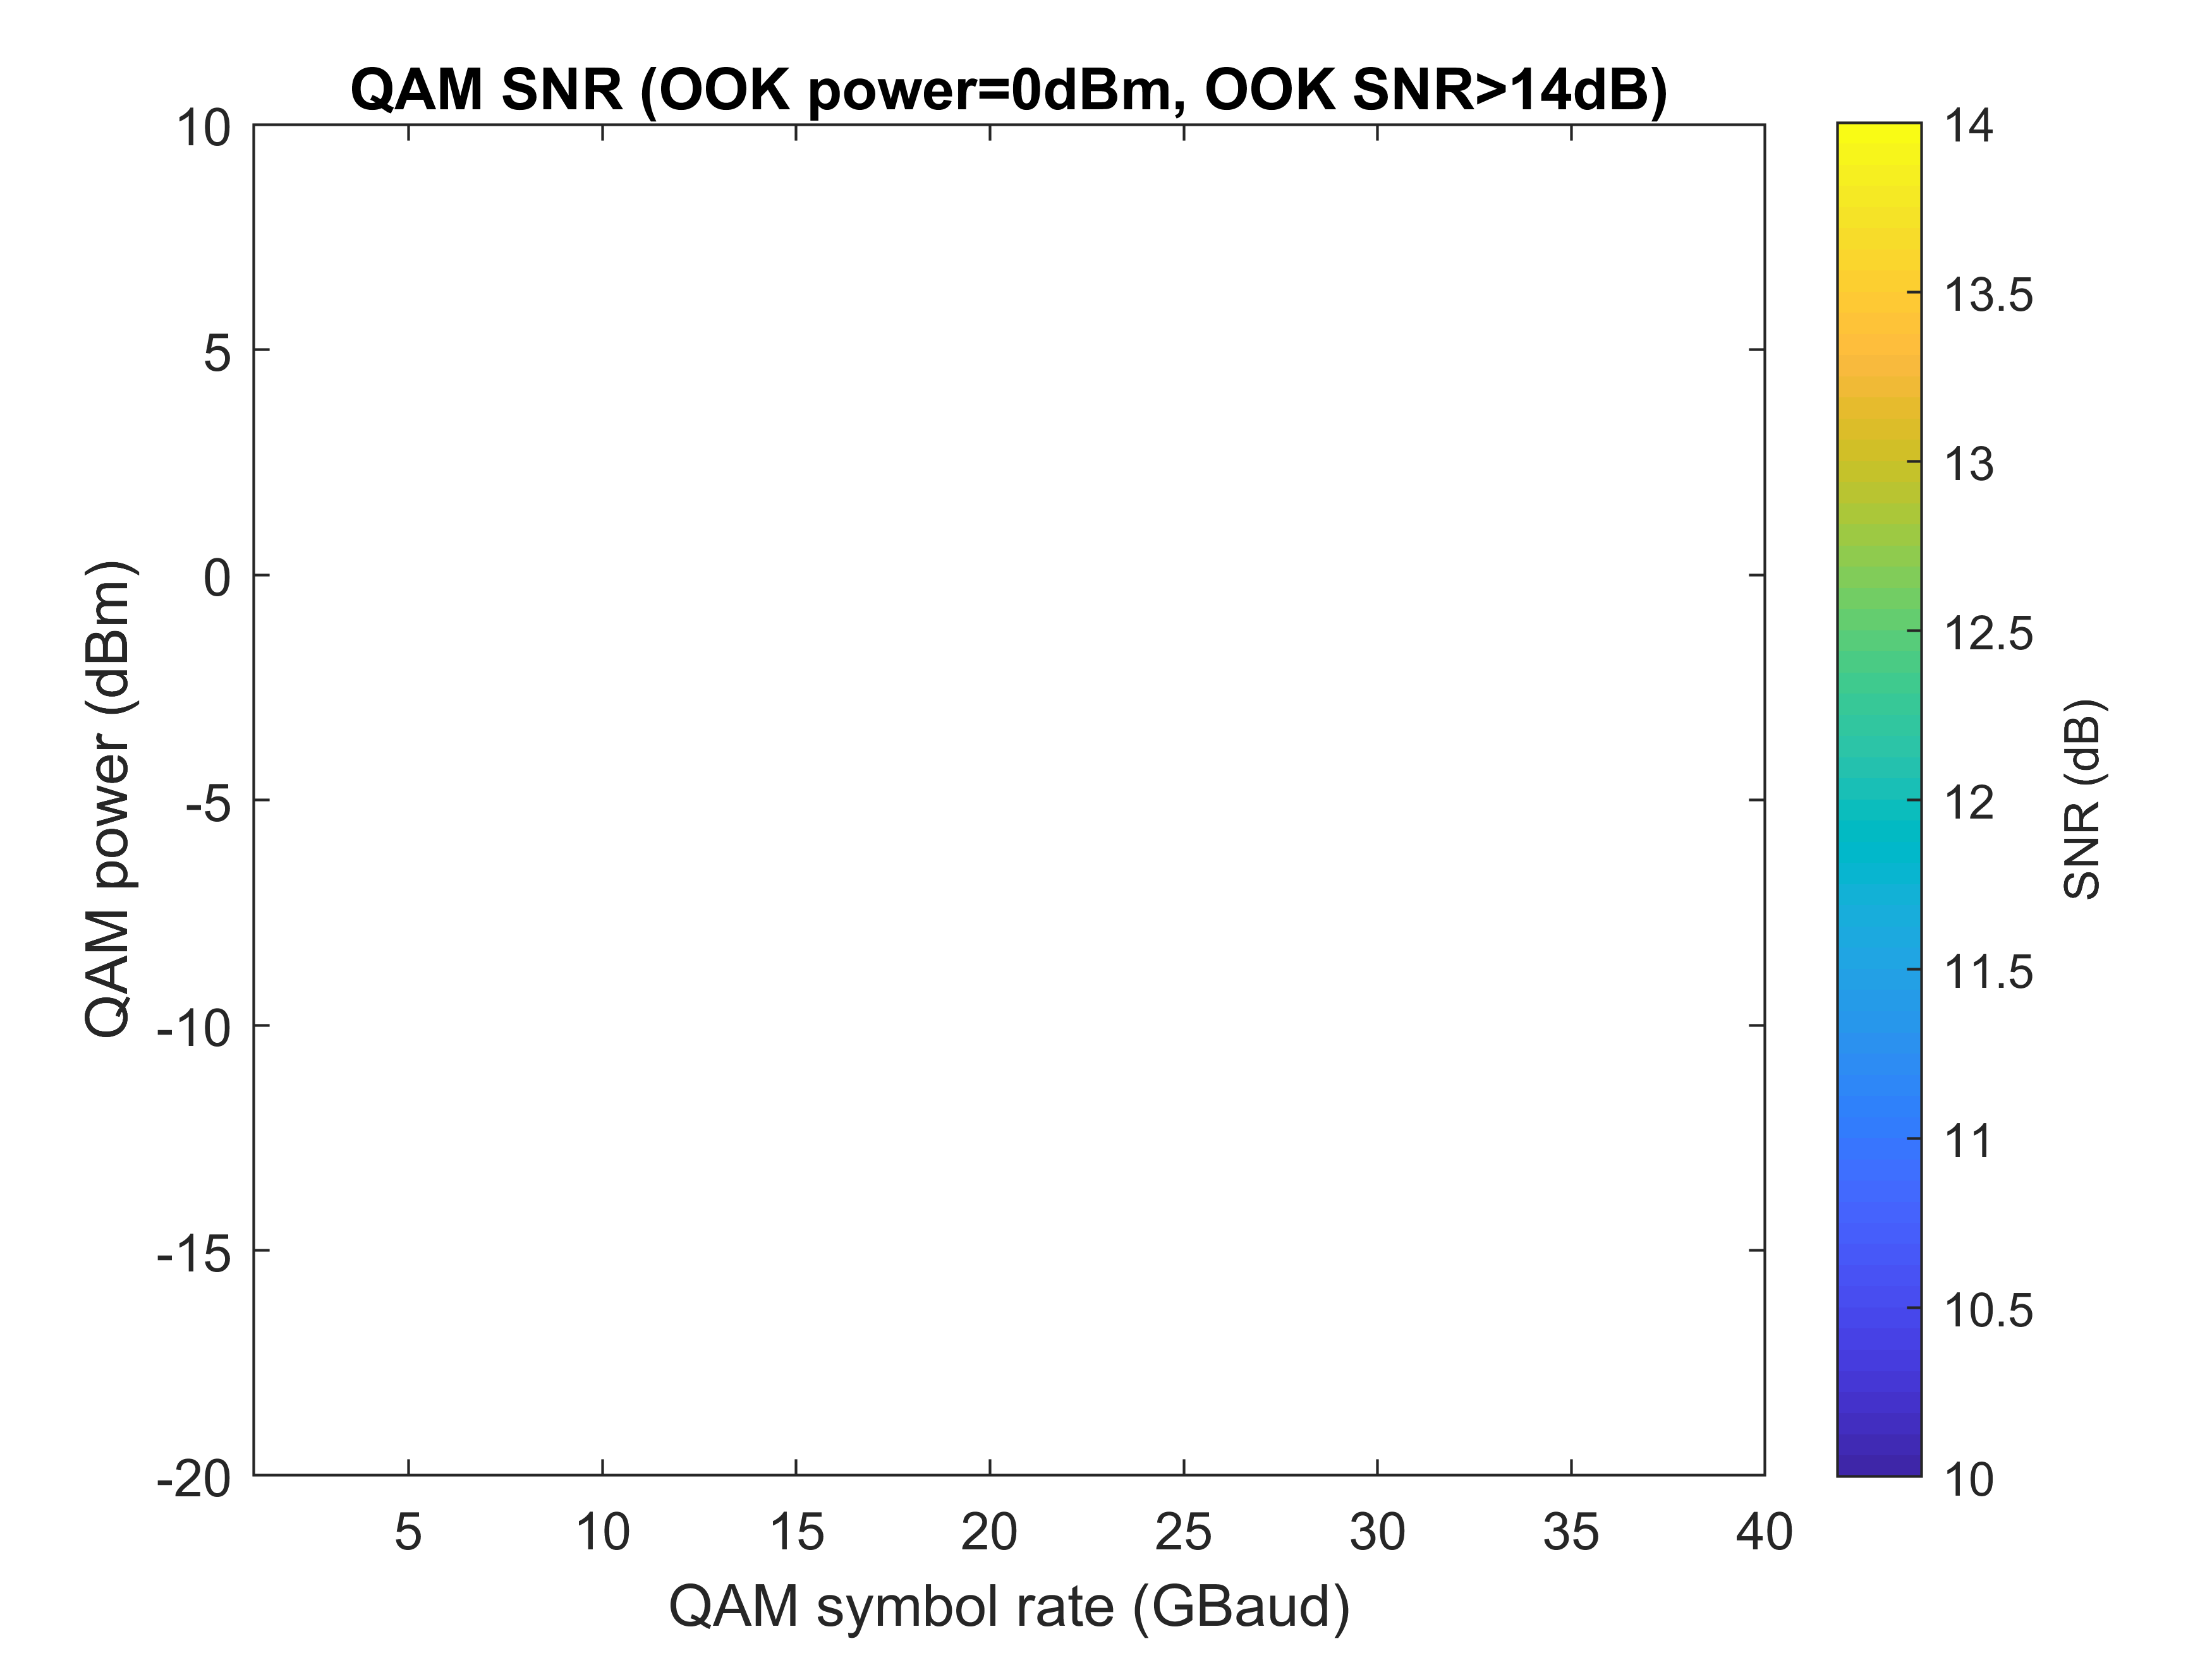
Interleaving OOK and 16QAM – Single Pol.
4OOKs: 50 GHz channel spacing

Slide 9
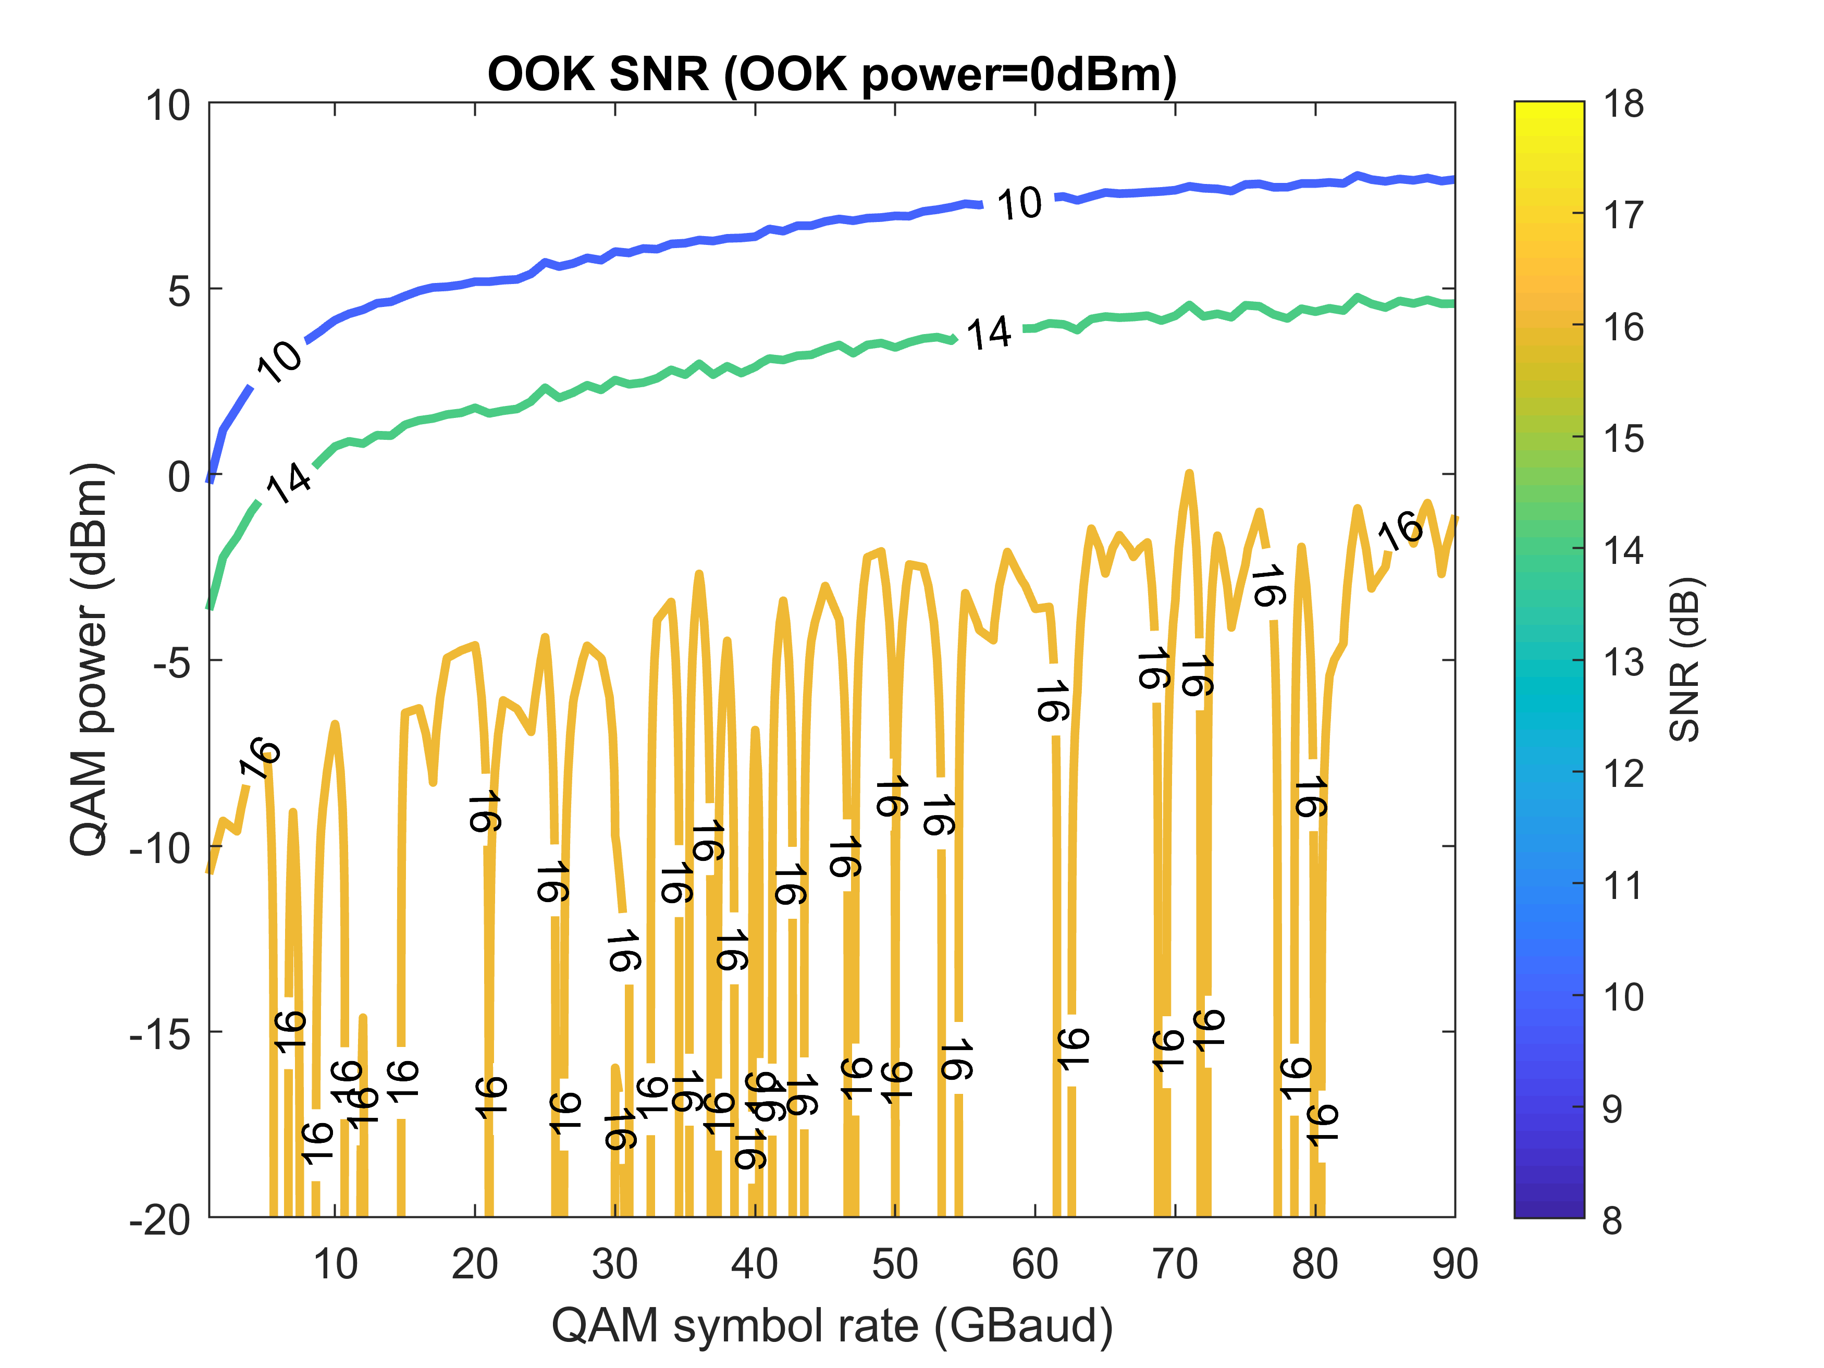
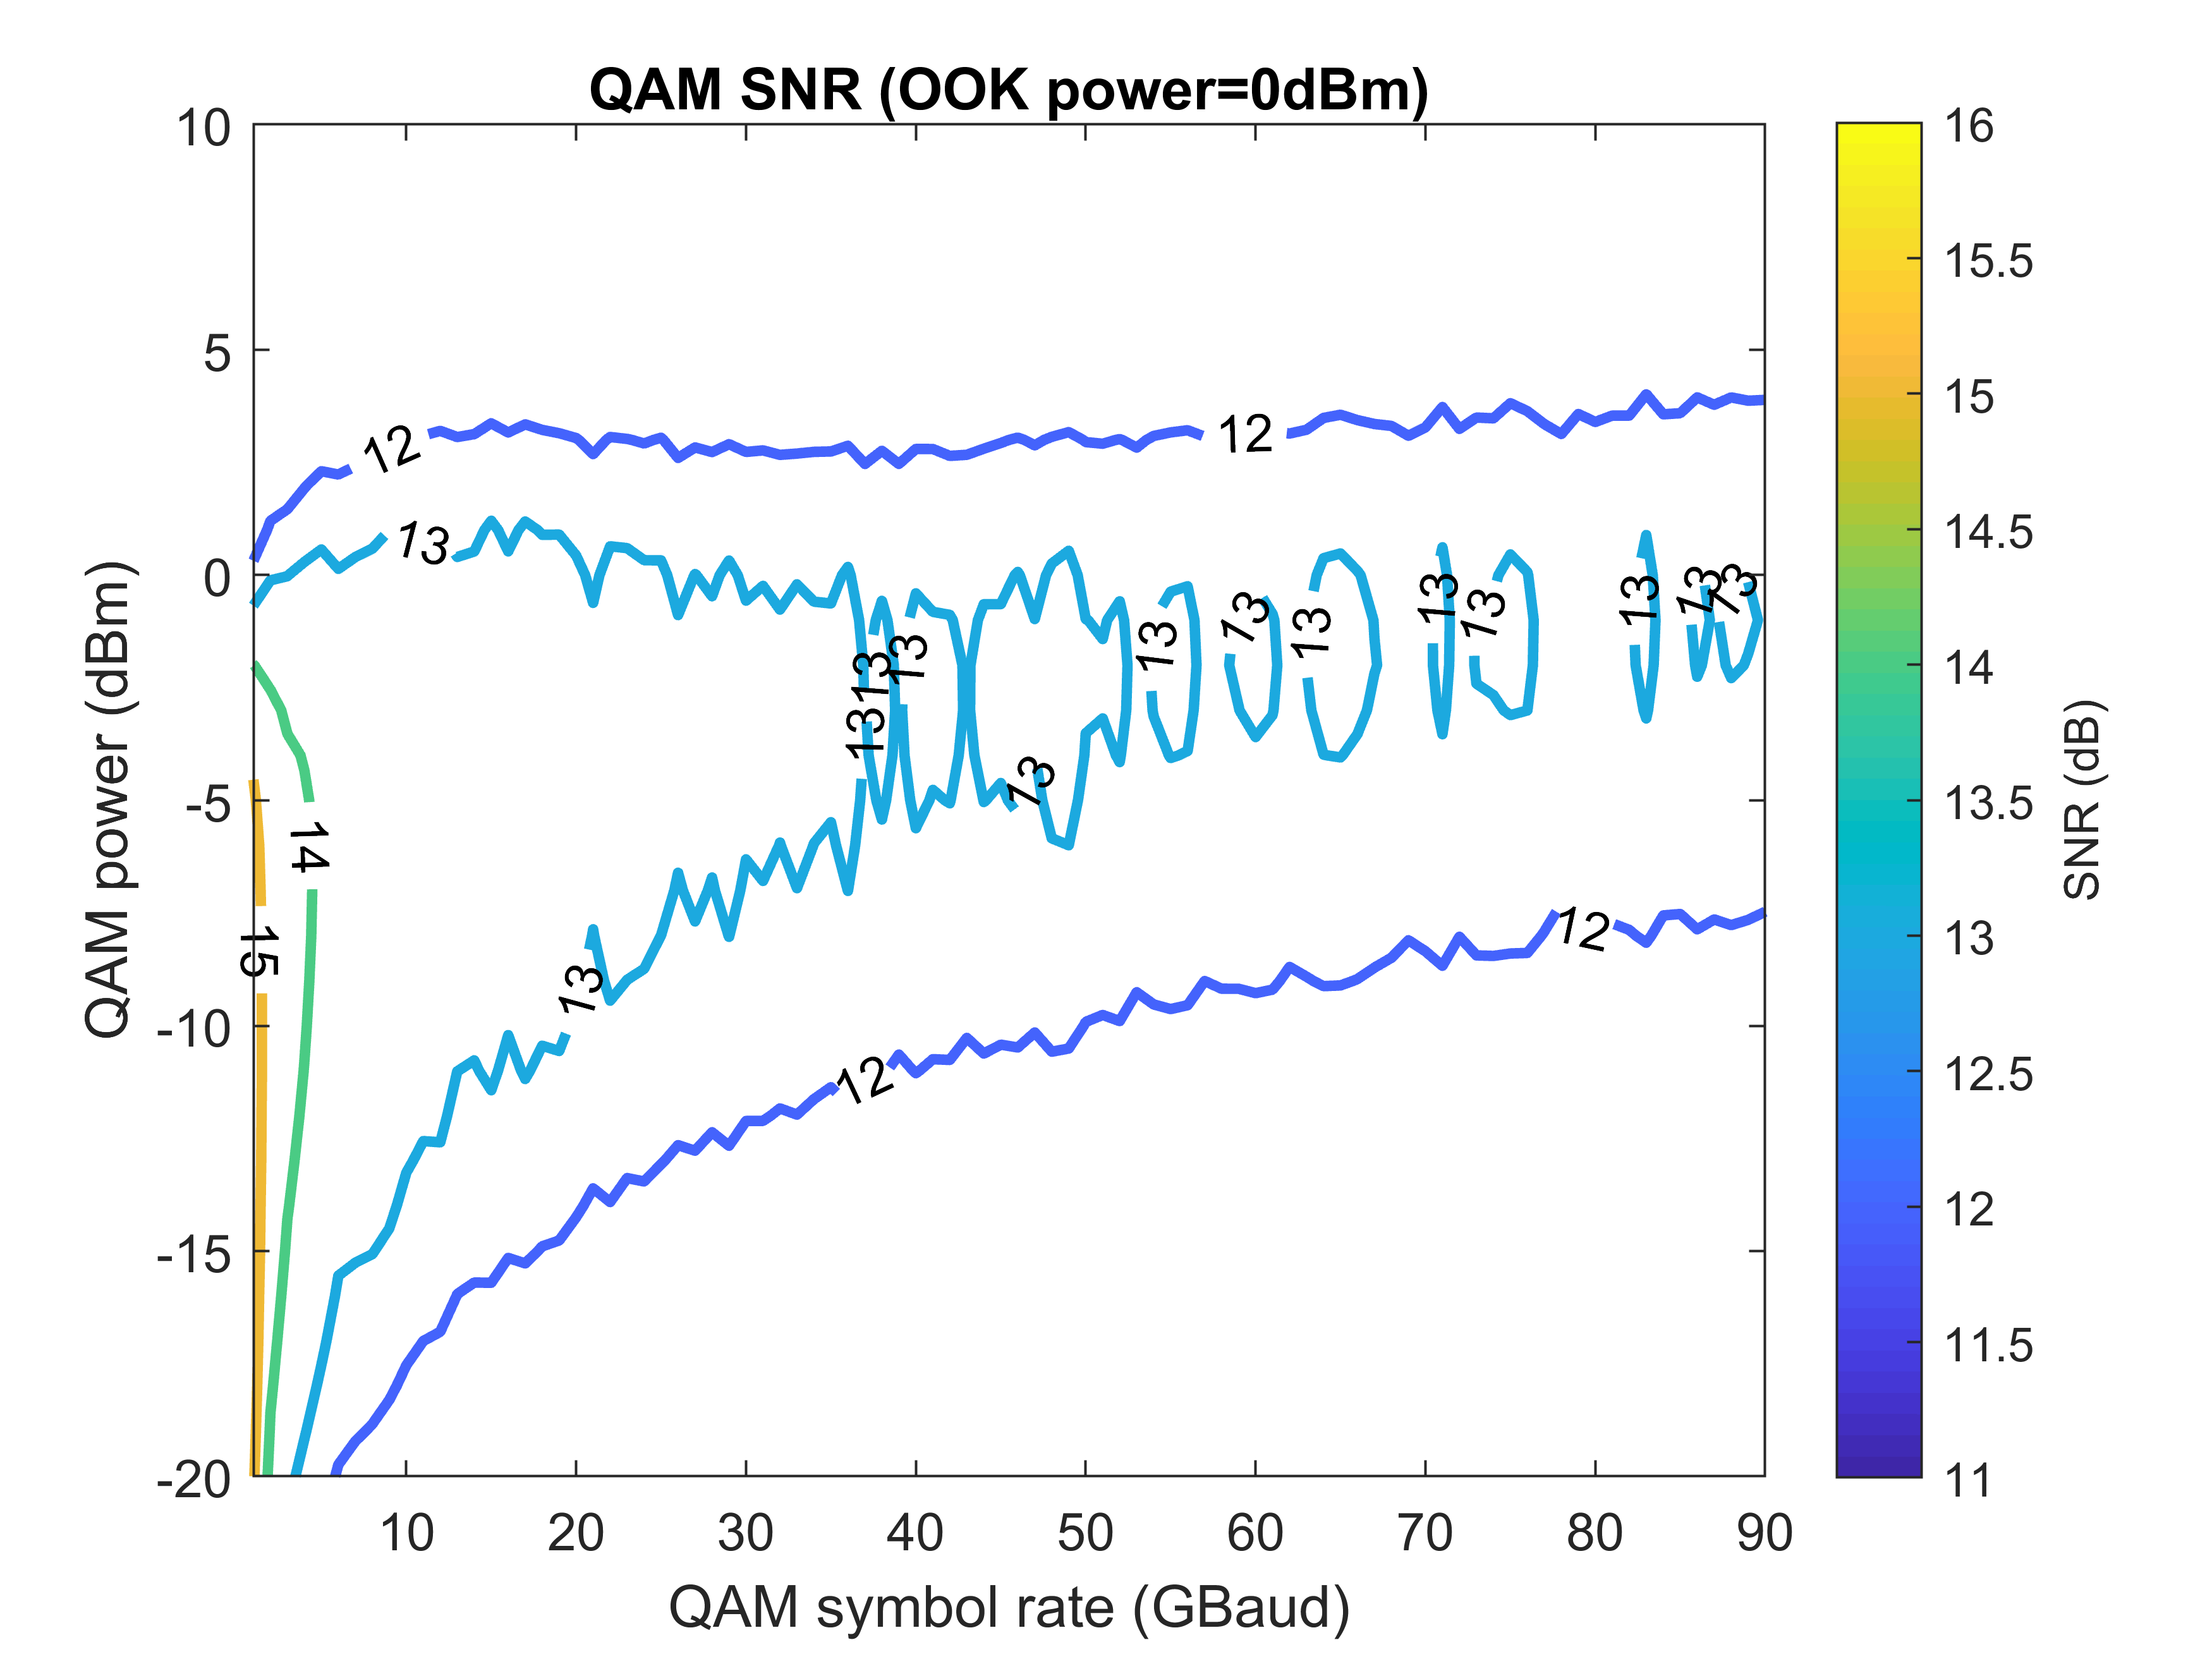
Interleaving OOK and 16QAM – Single Pol.
4OOKs: 100 GHz channel spacing

Slide 10
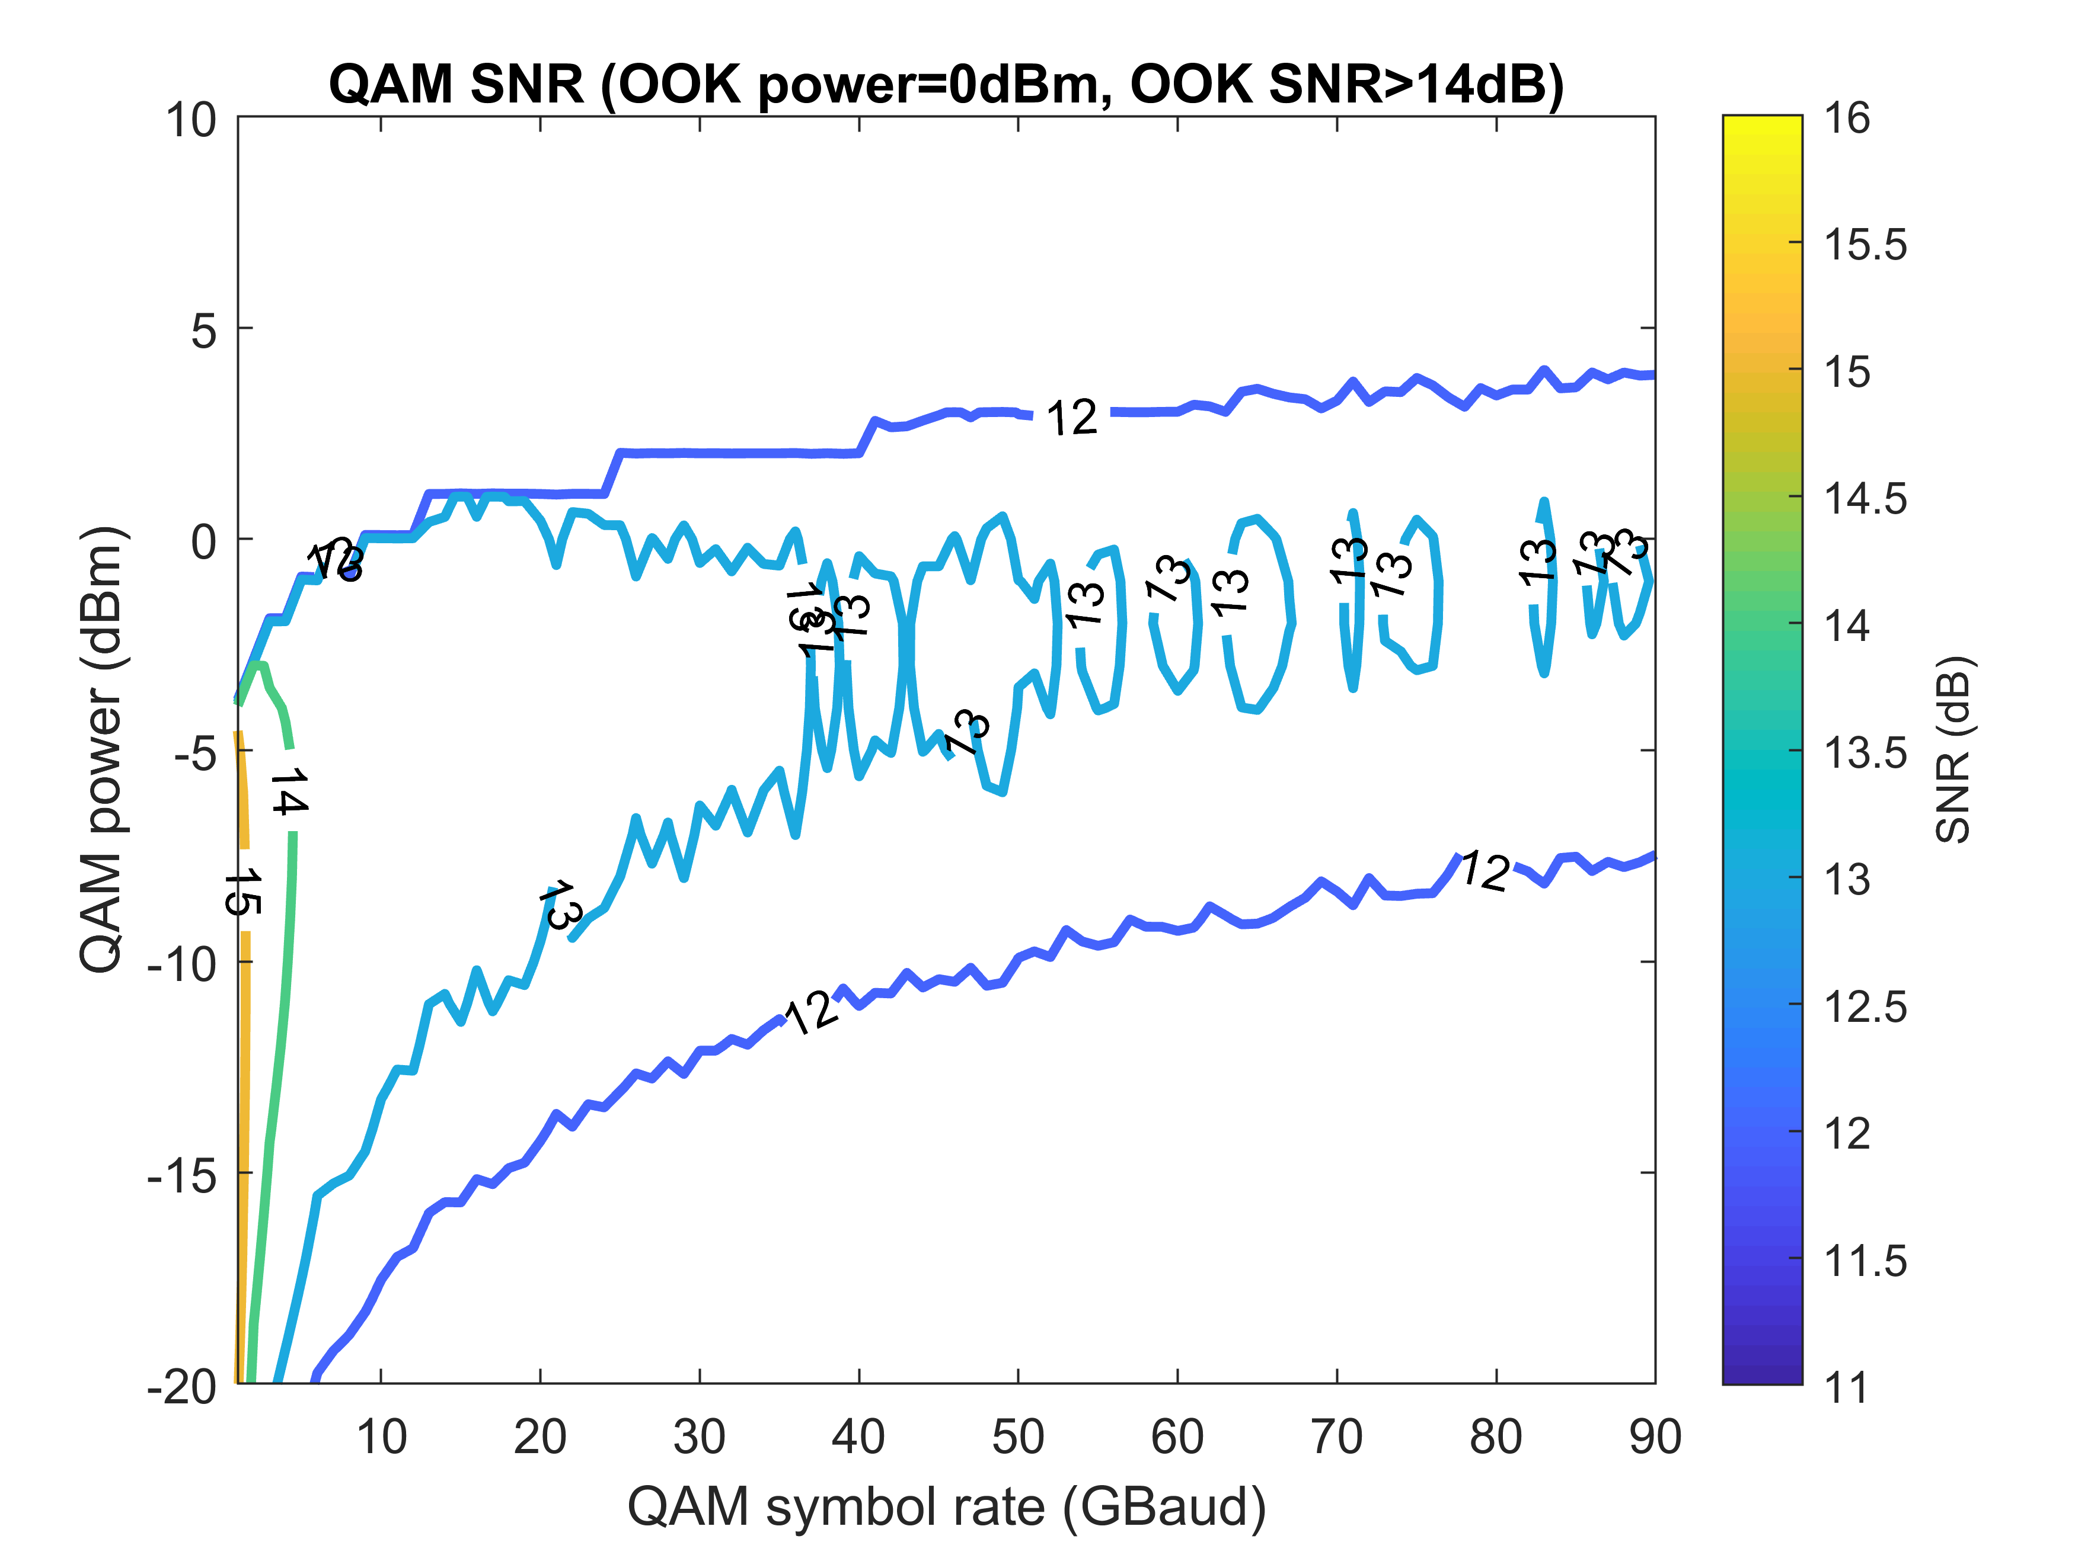
Interleaving OOK and 16QAM – Single Pol.
4OOKs: 100 GHz channel spacing

